Slide 1
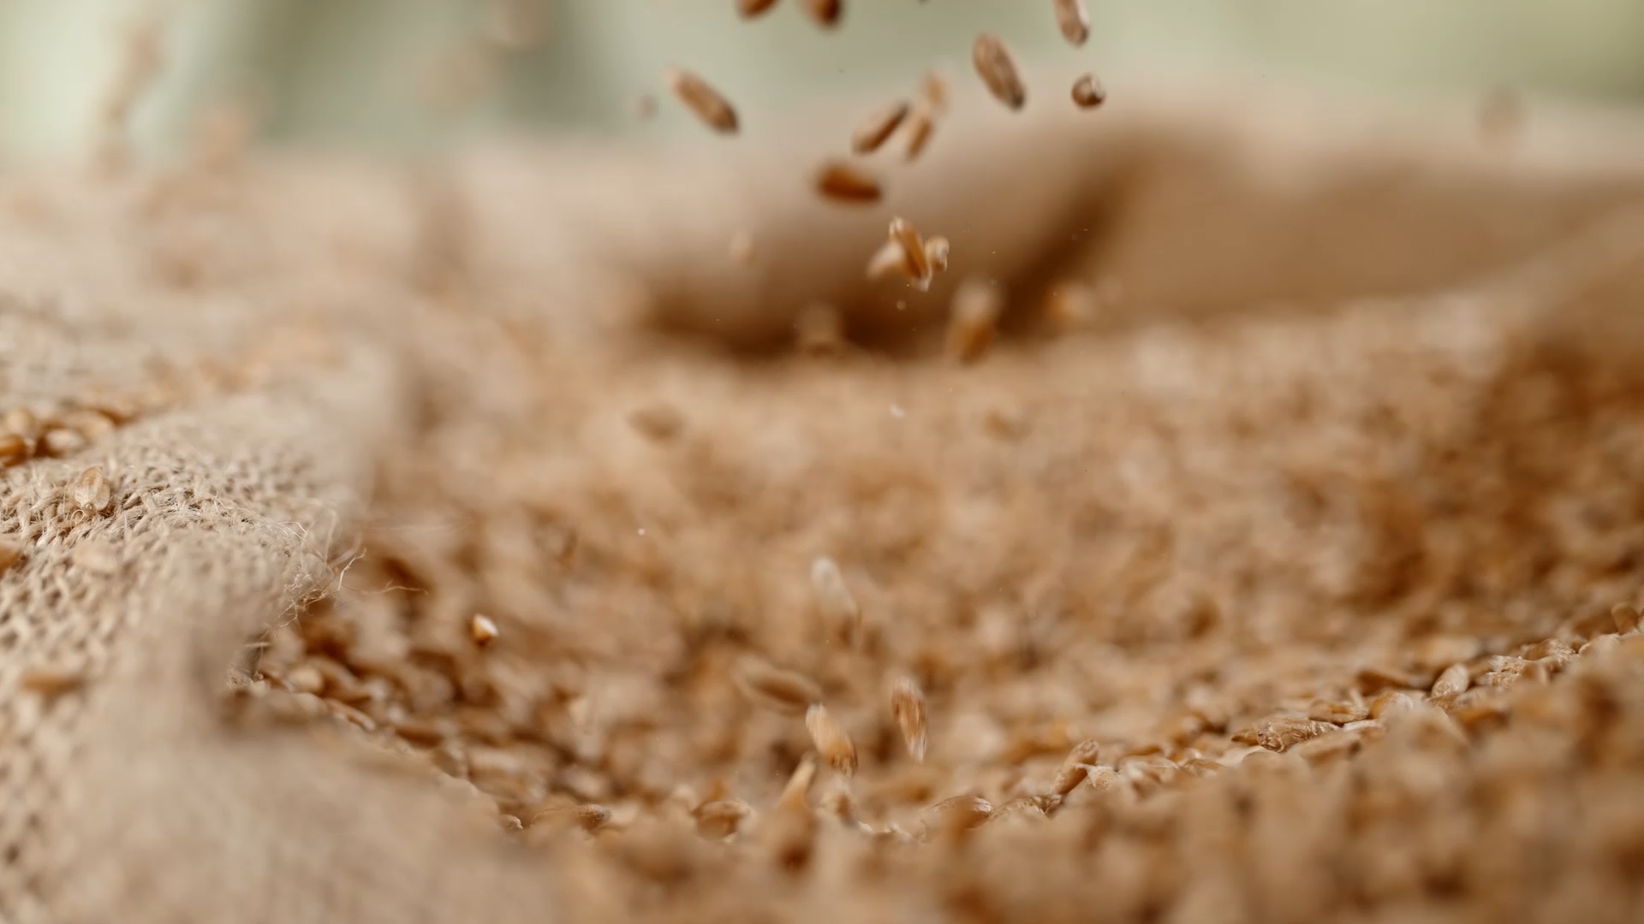
High Mowing Organic Seeds
Seed Sorting Model

Slide 2
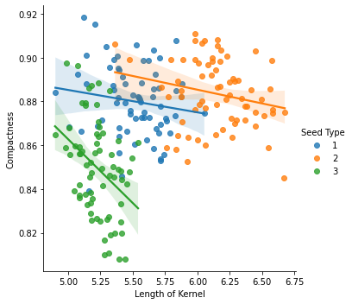
A Small Data Set For Testing
Notes:
70 of each of the three types of wheat seeds 210 total

Slide 3
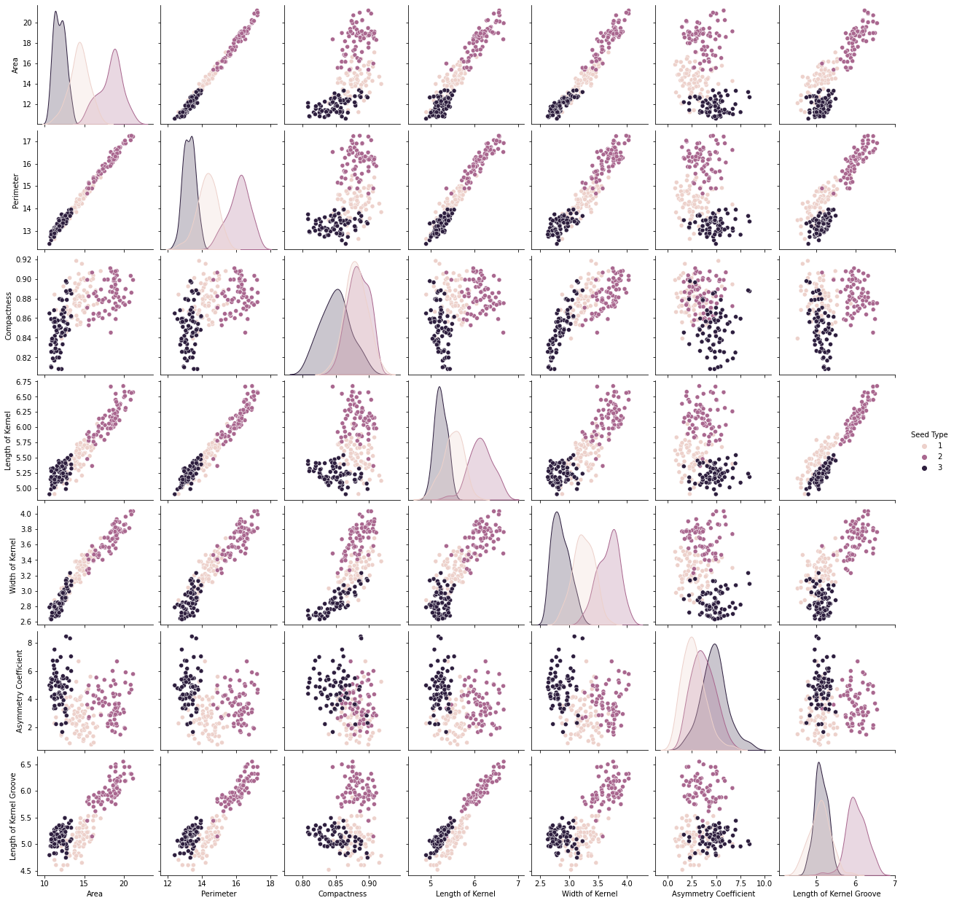
Very Similar Samples

Slide 4
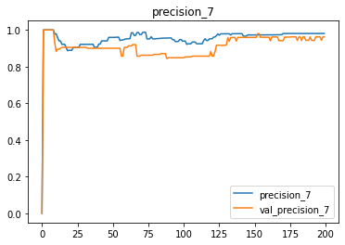
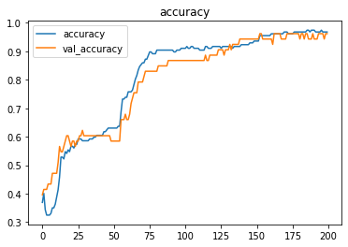
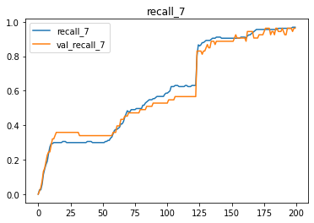
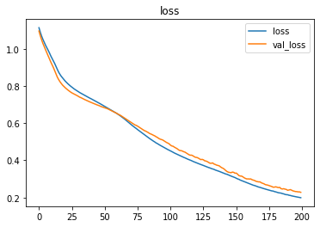
Keras for the win!!!

Slide 5
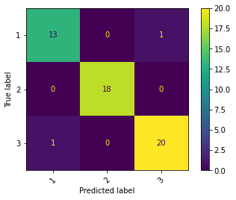
The Results!!!
precision recall f1-score support
0 0.93 0.93 0.93 14
1 1.00 1.00 1.00 18
2 0.95 0.95 0.95 21
Accuracy 0.96 53
Macro Ave 0.96 0.96 0.96 53
Weighted Ave 0.96 0.96 0.96 53

